Slide 1

DISCRETE MATHEMATICS
Chapter 1:
COLLECTION, MAPPING, AND RELATIONS
Presenter: Ph.D. Phu-Nguyen Le
June 7th, 2023
1

Slide 2
Contents
1.1. INTRODUCTION TO SET THEORY.
1.1.1 Definition.
1.1.2 Subset.
1.1.3. Set operation.
1.2. MAPPING.
1.2.1. Definition.
1.2.2 Domain and Image
1.2.3. Pictures of Functions.
1.2.4 Counting Functions
1.2.5. Inverse function.
2

Slide 3
1.1 Introduction to set theory.
1.1.1 Definition.
A set is a repetition-free, unordered collection of objects. A given object either is a member of a set or it is not—an object cannot be in a set “more than once.” There is no order to the members of a set. The simplest way to specify a set is to list its elements between curly braces
Example:
S= {1/2, 2, 3}
A= {1,2,3}
B= {e,2,j,l}
C= {car, motorbike, plane}
Z (the integers), N (the natural numbers), Q (the rational numbers), and R (the real number).
3
Notes:
For example, f(2; 3; 1/ 2) g is a set with exactly three members: the integers 2 and 3, and the rational number 1/ 2 .
No other objects are in this set
. All of the following sets are the same: f2; 3; 1 2 g f3; 1 2 ; 2g f2; 2; 3; 1 2 g:
It does not matter in what order we list the objects, nor does it matter if we repeat an object.
All that matters is what objects are members of the set and what objects are not.
In this example, exactly three objects are members of the set; no other objects are members

Slide 4

1.1 Introduction to set theory.
1.1.1 Definition.
An object that belongs to a set is called an element of the set.
Membership in a set is denoted with the symbol $∈$.
  x $∈$ A
Not membership in a set is denoted with the symbol $∉$.
  x $∉$ A
The number of elements in a set A is denoted $\left|A\right|$.
The cardinality of A: $\left|A\right|$ or $\#A$ : the cardinality or size of the set A
Finite and infinite set:
  Finite set: cardinality is an integer
  Infinite set: cardinality is not an integer
4
Notes:
The notation x $∈$ A means that the object x is a member of the set A.
For example, 2 2 f2; 3; 1 2 g is true, but 5 2 f2; 3; 1 2 g is false.
In the latter case, we can write 5 … f2; 3; 1 2 g;
the notation x … A means x is not an element of A.
When read aloud, 2 is pronounced “is a member of” or “is an element of” or “is in.”
Often mathematicians write, “If x 2 Z, then. . . .”
This means exactly the same thing as “If x is an integer, then. . . .”
However, the 2 symbol can also stand for “be a member of” or “be in.”
For example, if we write “Let x 2 Z,” we mean “Let x be a member of Z” or, more prosaically, “Let x be an integer.”
(The cardinality of A )is simply the stand for the cardinality or size of the set (i.e., the number of elements in that set). An alternative notation for the cardinality of a set is #A. number of objects in the set. The cardinality of the set f2; 3; 1 2 g is 3. The cardinality of Z is infinite. We also call jAj the size of the set A.

Slide 5

1.1 Introduction to set theory.
1.1.1 Definition.
  The empty set is the set with no members
  $∅$, {}
  Q/A: The cardinality of the empty set?
  How to specifying a set:
    + List elements of the set between curly braces: {1,2,3}
    + Set builder notation
    {dummy variable : conditions} : {x: x $∈$R, x>3}
    {dummy variable $∈$ set : conditions} : {x $∈$R: x>3}
    Q/A: Give examples
5
Notes:
List elements are appropriate for small Set-builder notation. sets. More often, set-builder notation is used.

Slide 6
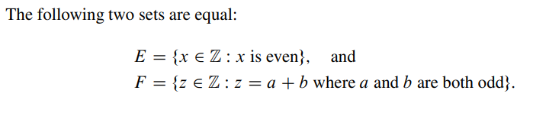

1.1 Introduction to set theory.
1.1.1 Definition.
  Proving two sets are equal.
    Let A and B be the sets.
    To show A = B,
    Suppose x $∈$ A. . . . Therefore x $∈$ B.
    Suppose x $∈$ B. . . . Therefore x $∈$ A.
    Therefore A = B.
  Using three dots (. . . ) to indicate that the pattern continues
    A= {1,2,3, . . .,400}
6

Slide 7

1.1 Introduction to set theory.
1.1.2 Subset.
  Suppose A and B are sets. We say that A is a subset of B provided every element of A is also an element of B. The notation A $⊆$ B means A is a subset of B.
  Example:
    A={1,2,3}
    B={1,2,3,4}
    A $⊆$ B
  A $⊆$ A
  $∅$ $⊆$ A
  Let x be anything and let A be a set; then x $∈$ A if and only if {x} $⊆$ A.
7

Slide 8
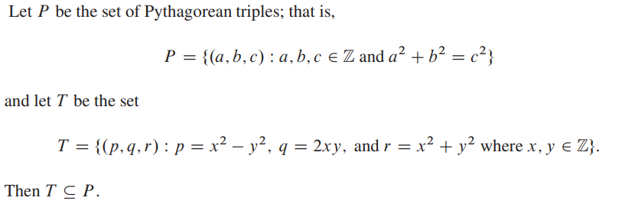
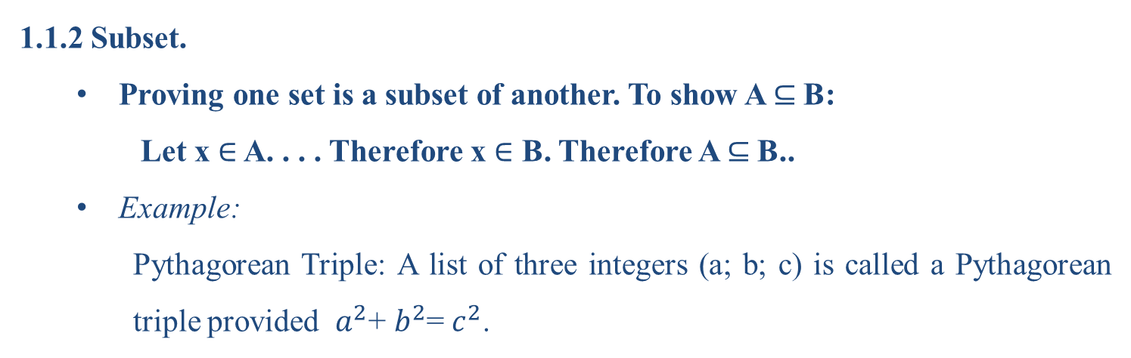
1.1 Introduction to set theory.
1.1.2 Subset.
  Proving one set is a subset of another. To show A $⊆$B:
    Let x $∈$ A. . . . Therefore x $∈$ B. Therefore A $⊆$B..
  Example:
    Pythagorean Triple: A list of three integers (a; b; c) is called a Pythagorean triple provided $a^{2}$+ $b^{2}$= $c^{2}$.
8

Slide 9
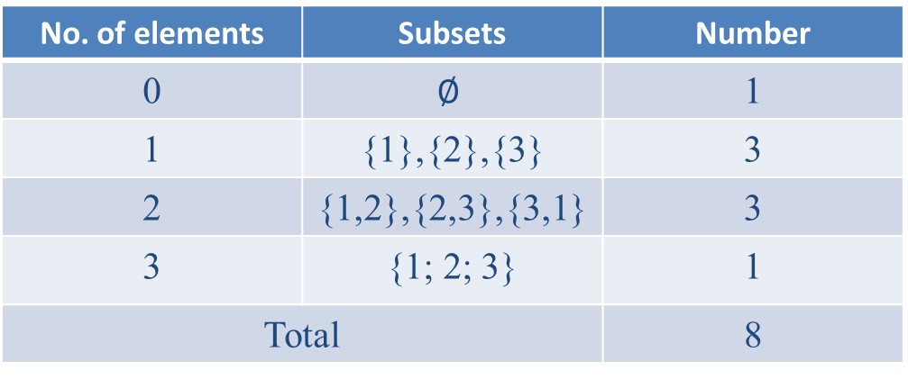
1.1 Introduction to set theory.
1.1.2 Subset.
  Counting subsets:
    How many subsets does A ={1; 2; 3} have?
No. of elements | Subsets | Number
0 | $$∅$$ | 1
1 | {1},{2},{3} | 3
2 | {1,2},{2,3},{3,1} | 3
3 | {1; 2; 3} | 1
Total |  | 8
9

Slide 10
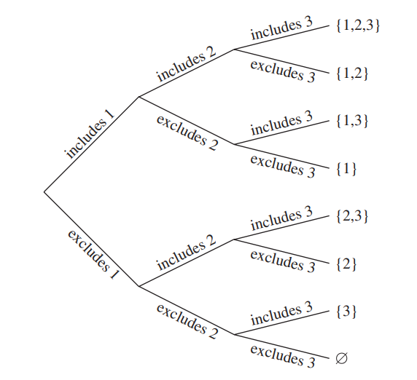
1.1 Introduction to set theory.
1.1.2 Subset.
  Counting subsets:
    How many subsets does A ={1; 2; 3} have?
Let A be a finite set. The number of subsets of A is $2^{\left|A\right|}$
10

Slide 11
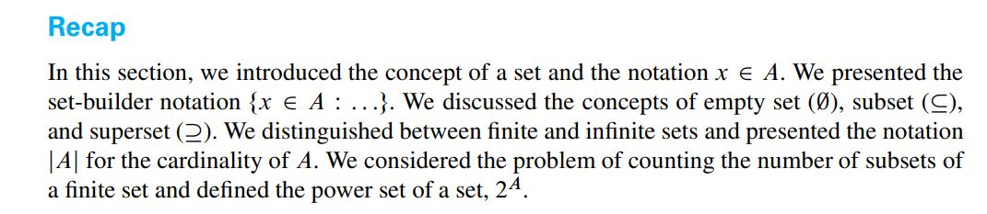

1.1 Introduction to set theory.
1.1.2 Subset.
    Power set
    Let A be a set. The power set of A is the set of all subsets of A
    For example,
    The power set of {1; 2; 3} is the set
    {$∅$, {1},{2},{3}, {1,2},{2,3},{3,1}, {1; 2; 3} }
    Exercises: 10.1,10.2,…,10.15
11

Slide 12

1.1 Introduction to set theory.
1.1.3 Set operation
Union and Intersection
Let A and B be sets.
The union of A and B is the set of all elements that are in A or B (or both). The union of A and B is denoted A $∪$ B.
The intersection of A and B is the set of all elements that are in both A and B. The intersection of A and B is denoted A $∩$B
In symbols, we can write this as follows:
A $∪$ B={ x:x $∈$A or x $∈$B}
A $∩$B ={ x:x $∈$A and x $∈$B}
Example:?
12
Notes:
Suppose A D f1; 2; 3; 4g and B D f3; 4; 5; 6g. Then A [ B D f1; 2; 3; 4; 5; 6g and A \ B D f3; 4g.

Slide 13

1.1 Introduction to set theory.
1.1.3 Set operation
Union and Intersection
Let A, B, and C denote sets. The following are true:
A $∪$ B = B $∪$ A and A $∩$B = B $∩$A. (Commutative properties)
A$∪($B $∪$C) = (A $∪$B) $∪$C and A $∩$(B $∩$C) = (A $∩$B) $∩$C.
(Associative properties)
A $∩$ $∅$= $∅$ and A $∪$ $∅$=A ;
A$∪($B$∩$C) = (A$∪$B) $∩($A$∪$C)
and A$∩($B$∪$C) = (A$∩$B)$∪($A$∩$C) (Distributive properties)
13

Slide 14
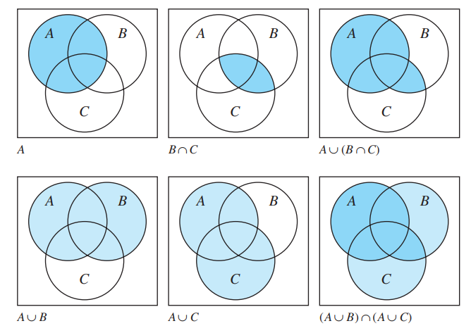
1.1 Introduction to set theory.
1.1.3 Set operation
Union and Intersection
14

Slide 15

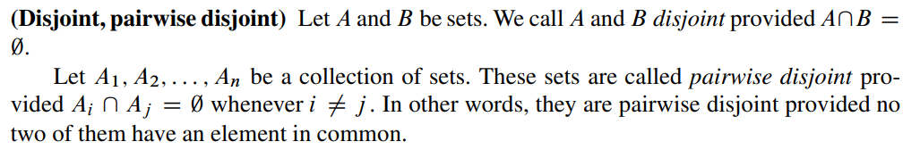

1.1 Introduction to set theory.
1.1.3 Set operation
The Size of a Union (cardinality of a Union)
Suppose A and B are finite sets. There is a simple relationship between the quantities $\left|A\right|,\left|B\right|,\left|A∪B\right|, and \left|A∩B\right|$.
15

Slide 16
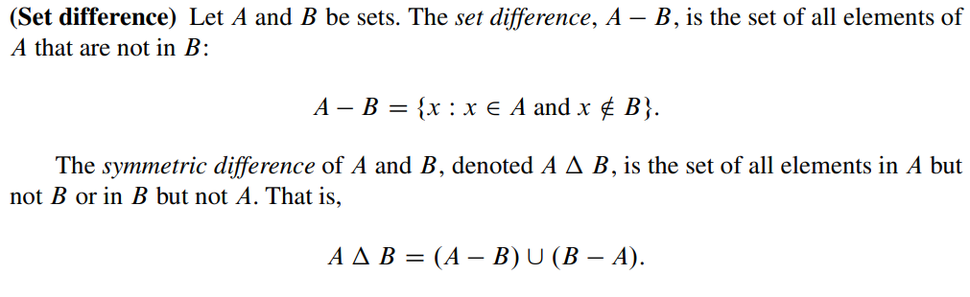
1.1 Introduction to set theory.
1.1.3 Set operation
Example: Draw Vein graph
16

Slide 17
1.1 Introduction to set theory.
1.1.3 Set operation
Example: Draw Venn graph
17

Slide 18
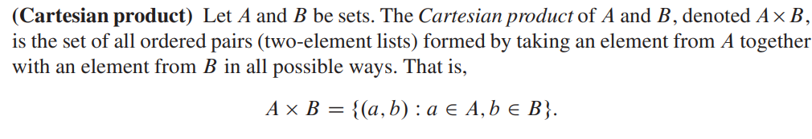
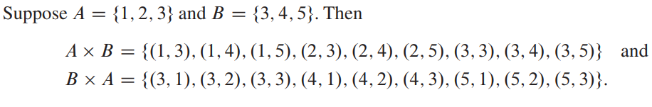

1.1 Introduction to set theory.
1.1.3 Set operation
18

Slide 19
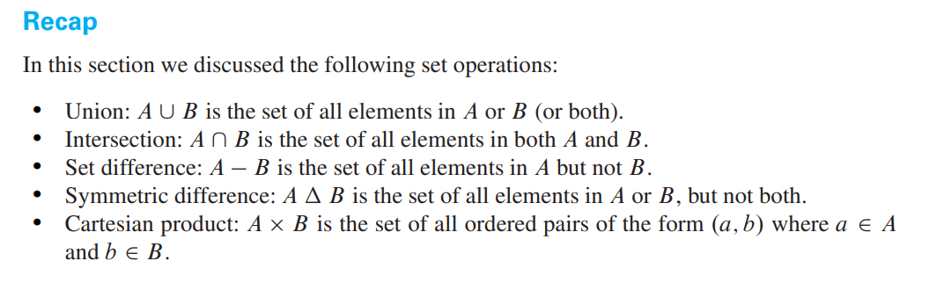
1.1 Introduction to set theory.
Exercises: 12.1-12.30
19

Slide 20
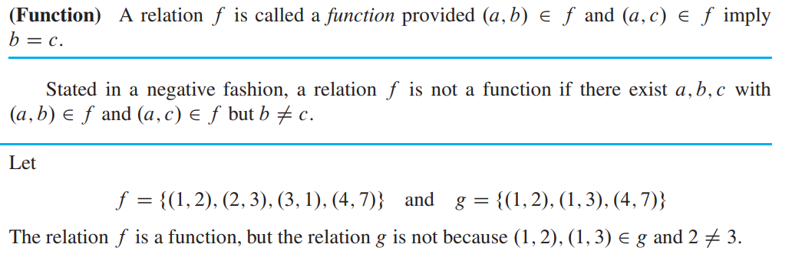
1.2 Mapping.
1.2.1 Definition.
Intuitively, a function is a “rule” or “mechanism” that transforms one quantity into another
20
Notes:
The concept of function is central to mathematics

Slide 21
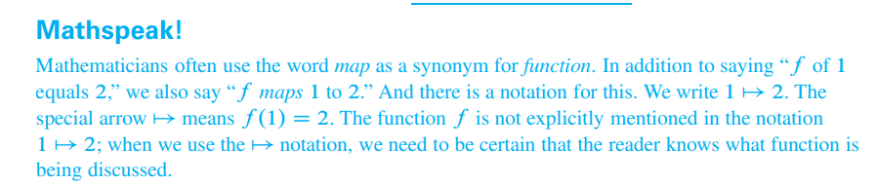
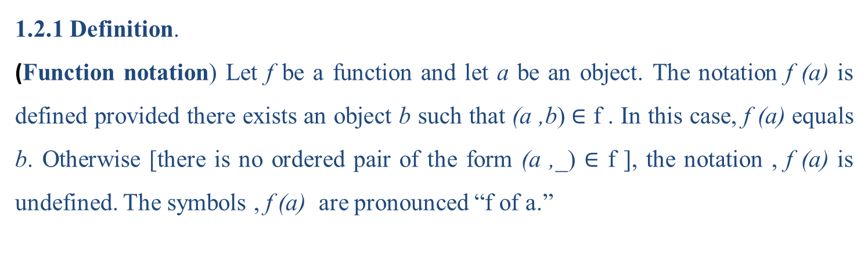
1.2 Mapping.
1.2.1 Definition.
(Function notation) Let f be a function and let a be an object. The notation f (a) is defined provided there exists an object b such that (a ,b) $∈$ f . In this case, f (a) equals b. Otherwise [there is no ordered pair of the form (a ,_) $∈$ f ], the notation , f (a) is undefined. The symbols , f (a) are pronounced “f of a.”
21
Notes:
The concept of function is central to mathematics

Slide 22
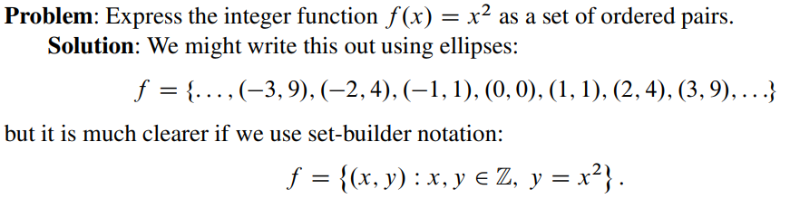
1.2 Mapping.
1.2.1 Definition.
22

Slide 23

1.2 Mapping.
1.2.2 Domain and Image .
(Domain, image) Let f be a function. The set of all possible first elements of the ordered pairs in f is called the domain of f and is denoted dom f . The set of all possible second elements of the ordered pairs in f is called the image of f and is denoted im f .
23

Slide 24
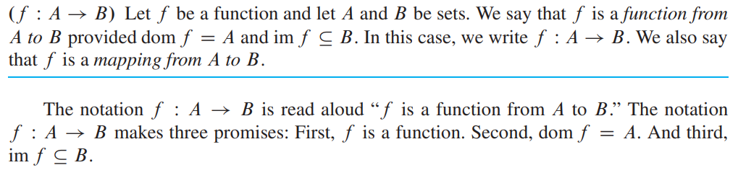
1.2 Mapping.
1.2.2 Domain and Image .
23

Slide 25
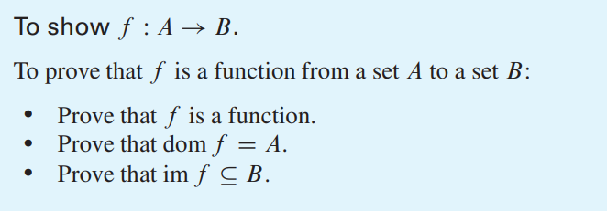
1.2 Mapping.
1.2.2 Domain and Image .
25

Slide 26
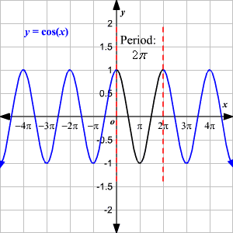
1.2 Mapping.
1.2.3 Pictures of Functions.
Graphs provide an excellent way to visualize functions whose inputs and outputs are real numbers.
Example:
26

Slide 27
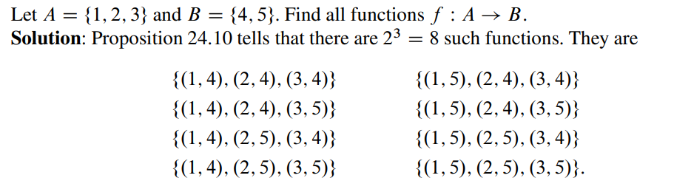
1.2 Mapping.
1.2.4 Counting Functions.
Let A and B be finite sets. How many functions from A to B are there?.
27

Slide 28
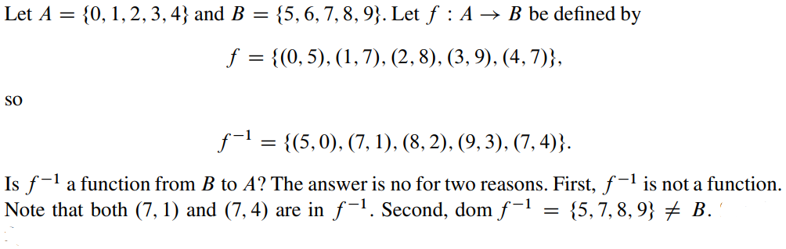
1.2 Mapping.
1.2.5 Inverse Functions.
The problem we consider here is: If f is a function from A to B, is f^-1 a function from B to A?
28

Slide 29
1.2 Mapping.
1.2.5 Inverse Functions.
29

Slide 30
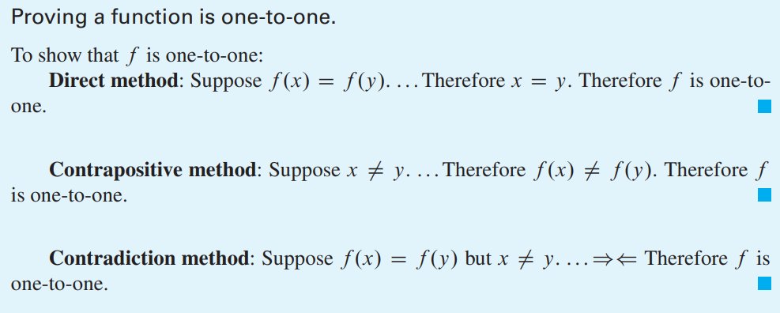
1.2 Mapping.
1.2.5 Inverse Functions.
30

Slide 31
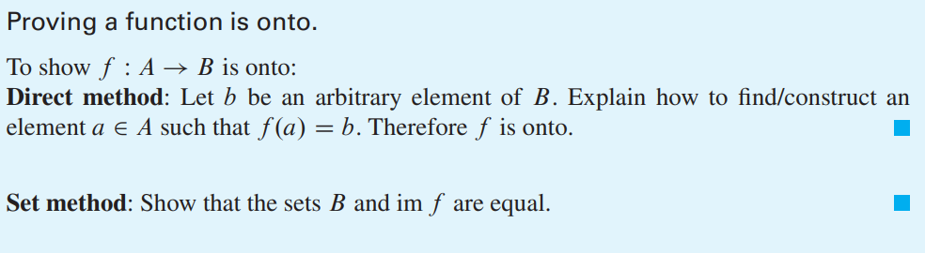
1.2 Mapping.
1.2.5 Inverse Functions.
31

Slide 32
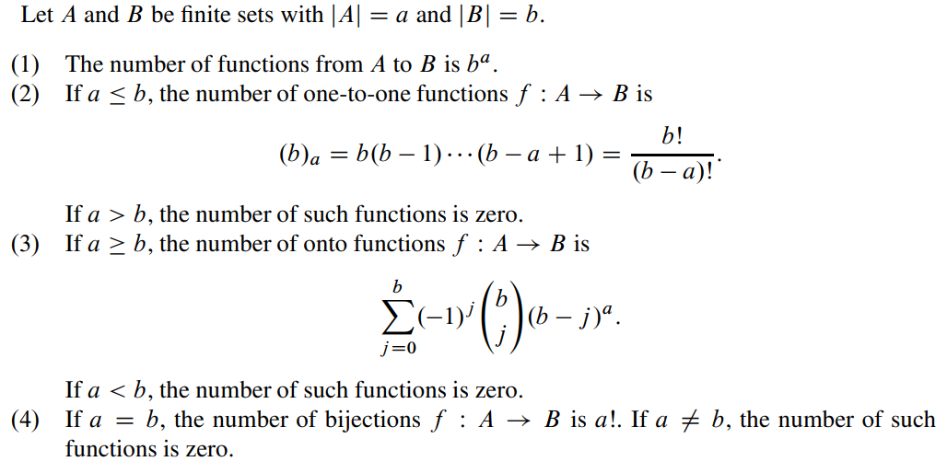
1.2 Mapping.
1.2.5 Inverse Functions.
32

Slide 33
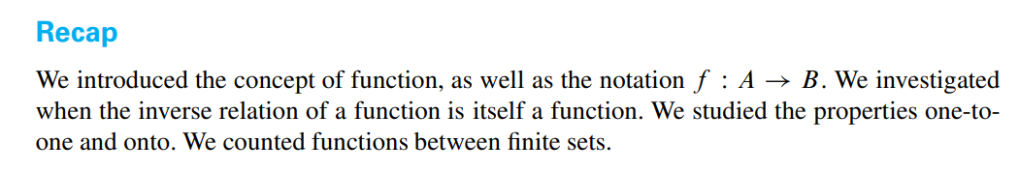
1.2 Mapping.
Exercises :24.1-24.24
33

Slide 34
THANK YOU!

